Slide 1
Employee Data Analysis using Excel
STUDENT NAME: SRAVANTHI R
REGISTER NO:2213391036252/ 8F6B8762992C56E88FB4ED28C7318812
DEPARTMENT:BCOM GENERAL
COLLEGE : Queen Mary’s College

Slide 2
PROJECT TITLE
Employee Performance Analysis using Excel

Slide 3


AGENDA
Problem Statement
Project Overview
End Users
Our Solution and Proposition
Dataset Description
Modelling Approach
Results and Discussion
Conclusion
3/21/2024 Annual Review

Slide 4

PROBLEM STATEMENT
Prformance analysis are made to a employees.
Increment to check the performance track of
the employees and it is useful for the
employees personal as well as organizational
growth.
So, the employees performance analysis helps
to require all the problems and have a
successful organisation.

Slide 5

PROJECT OVERVIEW
.
Analysing the performance of the employees by
considering the various factors like;
Gender,
Performance score and
Ratings.
Their involvement in work and various scores that analysis
the performance of employees in the organisation.

Slide 6


WHO ARE THE END USERS?
Employees Employer Manager,
Gets benefits from the performance of appraisal

Slide 7

OUR SOLUTION AND ITS VALUE PROPOSITION
Conditional Formatting – missing values
Filtering : remove missing data
Formulas : performance evaluation
Pivot : summary
Graph : data visualisation

Slide 8
Dataset Description
EMPLOYEES DATABASE KIGGLE
There are 26 features but we consider 9 features
Employees ID Numerical data
Name Text
Performance Level
Gender Male Or Female
Employees rating Numerical data.

Slide 9

THE "WOW" IN OUR SOLUTION
Sample Queries:
1. Get all characters in a guild: `SELECT * FROM Characters JOIN
Members ON CharacterID = CharacterID WHERE GuildID =
[GuildID]`
2. Get all raids a character has participated in: `SELECT * FROM
Raids JOIN RaidMembers ON RaidID = RaidID WHERE CharacterID
= [CharacterID]`
This database design captures key WoW data and relationships,
enabling you to store.
3/21/2024 Annual Review
9

Slide 10
MODELLING
1.Data collection
2.Feature collection
3.Data cleaning
4.Performance level
5.Summary
6.Visualisation
10

Slide 11
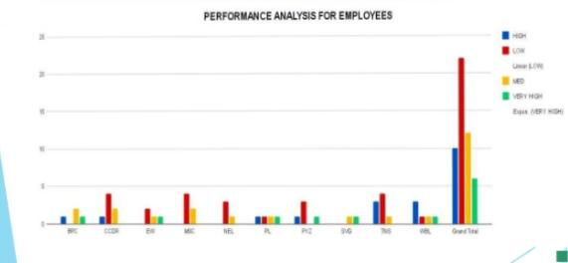
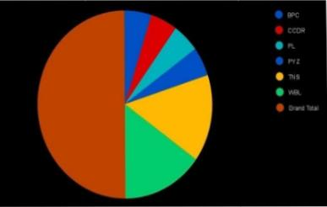
RESULTS
11

Slide 12
conclusion
While comparing the performance of
employees, the number of employees are
higher in number is in the average
performance where excellence employees are
less in percentage. So to overcome this we
should motivate the employees by giving there
different tasks based on their skills to improve
their performance in their work.

Slide 13
Thank you 🙏🏻

